Slide 1
AUTOMATIC CHESSBOARD
CAPSTONE PROJECT
Parv Gupta
Naman Malik
Devansh Gupta
Aditya Ranaut
Vaibhav Goyal

Slide 2
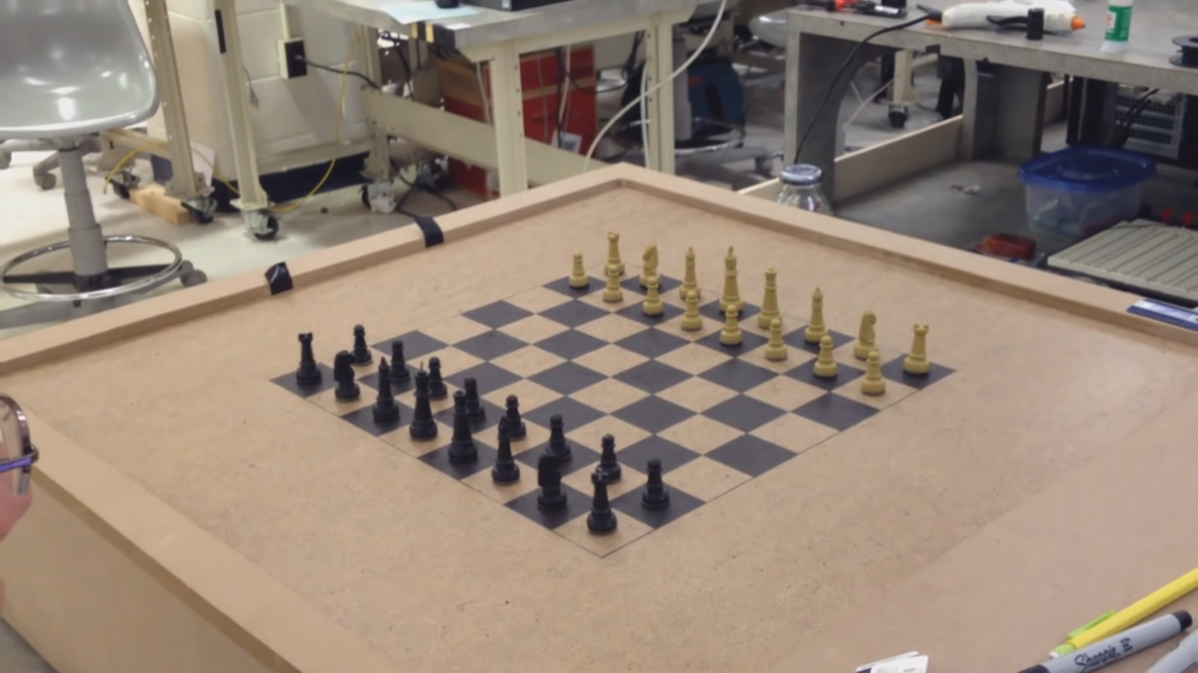
Our Goal

Slide 3
Introduction
Our idea is a chessboard integrated with AI and automated movements.
We aim to design a physical board with intelligent AI and with advanced robotics movements.

Slide 4
Scope
Play with World
As our Automated Chessboard’s globally connected gameplay, challenge anyone, anywhere across the world.
Play Against the Board
Automated Chessboard’s built-in AI ensures that you always has someone to play with.
Chess is for Everyone
Chess enhances your child’s mental dexterity and helps the elderly fight the onset of Alzheimer’s Disease, making it an ideal for all ages.

Slide 5
Technologies Used
Motors
TCP web sockets
Web Application
AI/ML Engine
Web Services
IOT Cloud
ESP Module

Slide 6
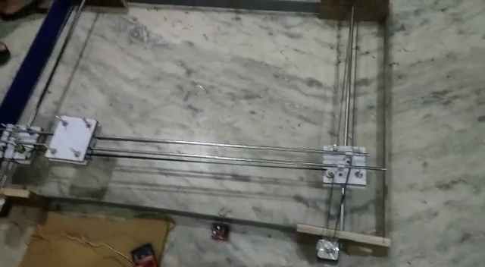
Sample Video of Mechanics

Slide 7
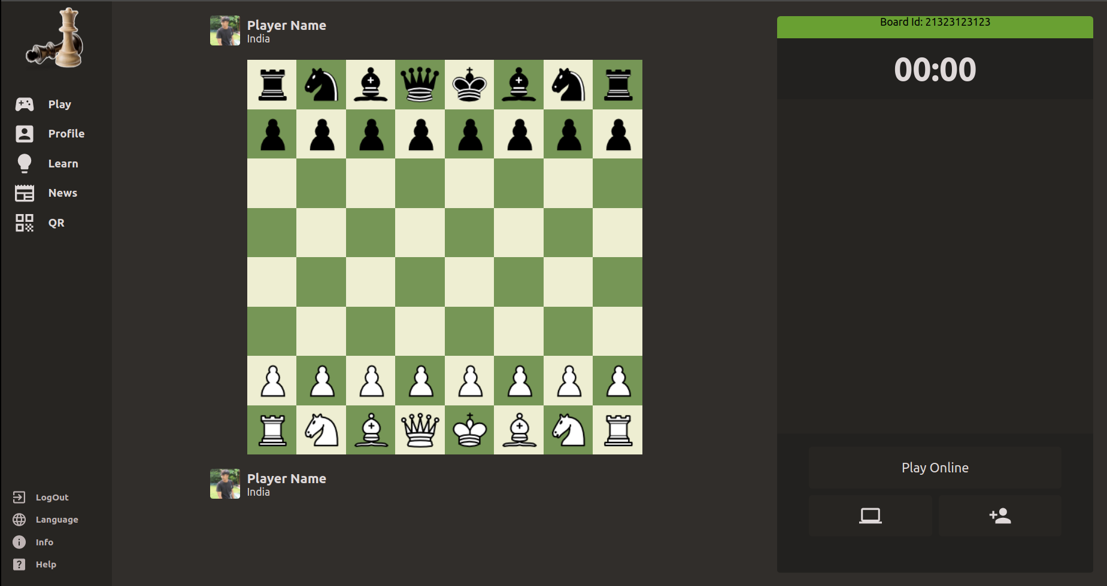
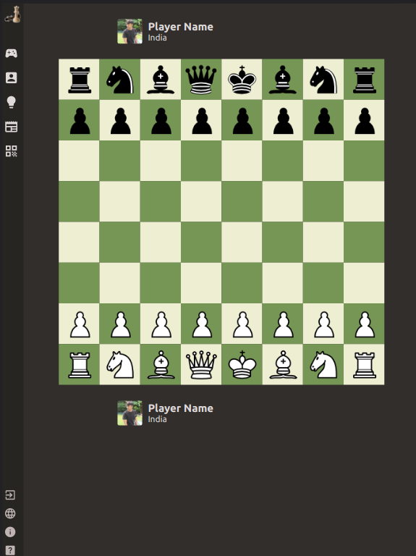
Our Work So Far

Slide 8
Thank You for Watching!
Any Questions?

